Slide 1
Nash Equilibrium Methods
To Train
Generative Adversarial Models
Karthick Krishna M EE21B067
Vamsi Krishna Chilakamarri EE21B153

Slide 2
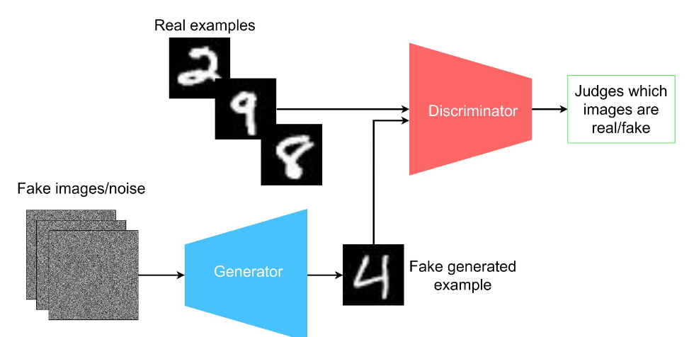
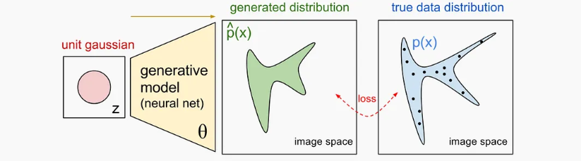
Generating New Images using AI
Maximising Likelihood
Learn Data Distribution
Adversarial Methods
Learn to Fake data samples

Slide 3
Generative Adversarial Models (GANs)
2 Player Game

Slide 4
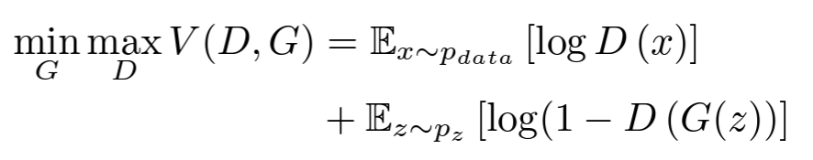
Generative Adversarial Models (GANs)
Discriminator Identifies Real Data as Real
Discriminator Identifies Fake Data as Fake

Slide 5
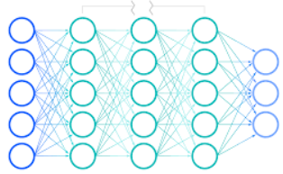
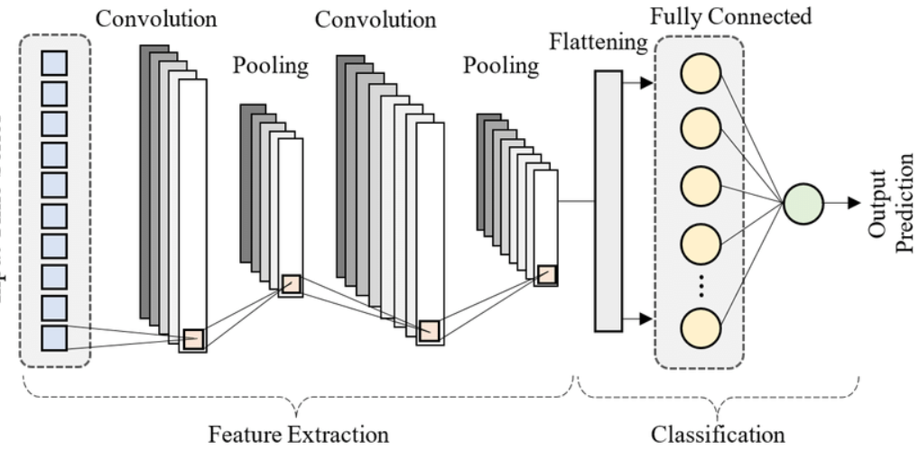
Generative Adversarial Models (GANs)
Generator
G
Generated
G(z)
Random Seed (z)
Classifier
C
Real(1)
Fake(0)
Real (x)

Slide 6
Generative Adversarial Models (GANs)
Training:
1) Sample True Data samples and Generator Samples.
2) Train Discriminator by freezing Generator.
3) Train Generator by freezing Discriminator
4) Loop
Discriminator Identifies Real Data as Real
Discriminator Identifies Fake Data as Fake

Slide 7
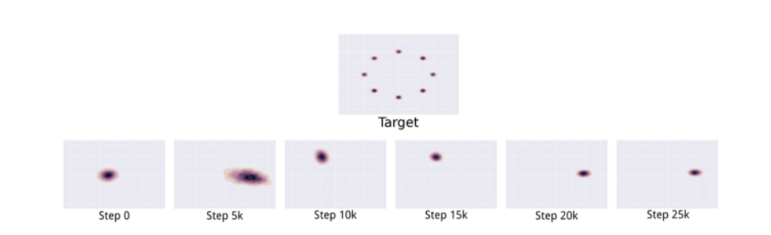
Drawbacks
Mode Collapse
Convergence to Local Optima

Slide 8
GANGs: Generative Adversarial Network Games
Frans A. Oliehoek, Rahul Savani,Jose Gallego-Posada, Elise van der Pol, Edwin D. de Jong, Roderich Groß
Problems with Original GAN Paper:
1) Lack of Formal Game-Theoretic Justification.
2) Absence of Consideration for Resource Constraints
3) Non-Convergence and Lack of Equilibrium in Practice

Slide 9

Formulating GANs as Zero Sum Games
Utilities of G and C in the original setting:
This is equivalent to a zero sum game with utilities:

Slide 10

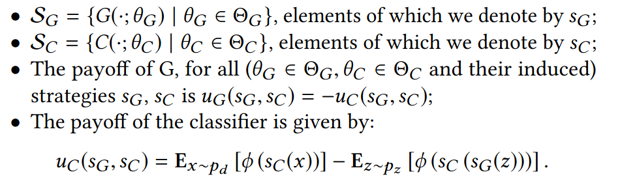
Game Theoretic Formulation of GANGs
Zero Sum Strategic-Form Game

Slide 11
Motivation behind GANGs
Provide Game Theoretic Insights to GANs
Obtain Global Nash Equilibrium
Mixed Strategies to Avoid Local Equilibrium and Mode Collapse
Learn an Approximate formulation of the game for real constraints
- Advancements in Parallel Nash Memory

Slide 12


Finite Games
Set of Players and Strategies is Finite.
Approximate GANGs as Finite Games :- Floating Point Approximation
Minimax Theorem
Approximate Equilibrium (epsilon-NE):

Slide 13
Finite Games
Set of Players and Strategies is Finite.
Approximate GANGs as Finite Games :- Floating Point Approximation
Local Nash Equilibrium (LNE):
Neither Player can Deviate in a neighbourhood of profile
Every LNE = NE in Mixed Strategy Finite Games

Slide 14





Resource Constrained Best Response
Only involve solutions feasible with computational budget
: Resource Constrained Strategies for Best Response Candidate
RBBR (Resource Bounded Best Response):
Resource Bounded Best Response Function:
such that

Slide 15


Resource Bounded GANG
Tuple
(RB-NE)Resource Bounded Nash Equilibrium:
Strategy Profile if
Theorem:

Slide 16
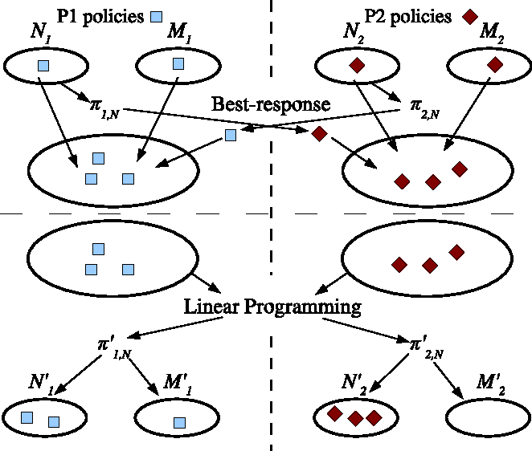
Parallel Nash Memory

Slide 17
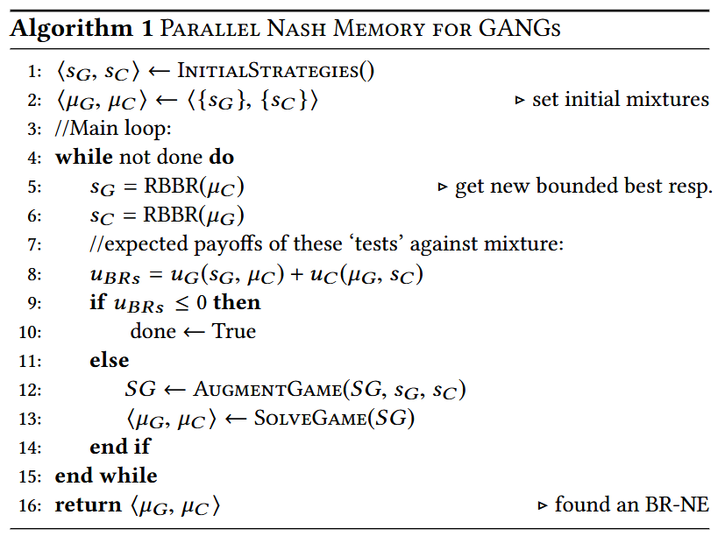
PNM Algorithm for Training GANs

Slide 18
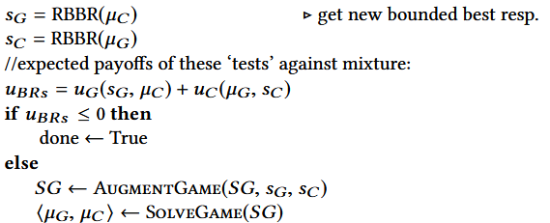

Convergence of PNM Algorithm
If u_{BRs}<=0 :
The number of pure strategies encountered and the support of SG monotonically increases, and by the finite game argument convergence is guaranteed
(There exists literature on search heuristics to calculate BR that involve solving POMDPs that arise out of the mixed strategies)

Slide 19
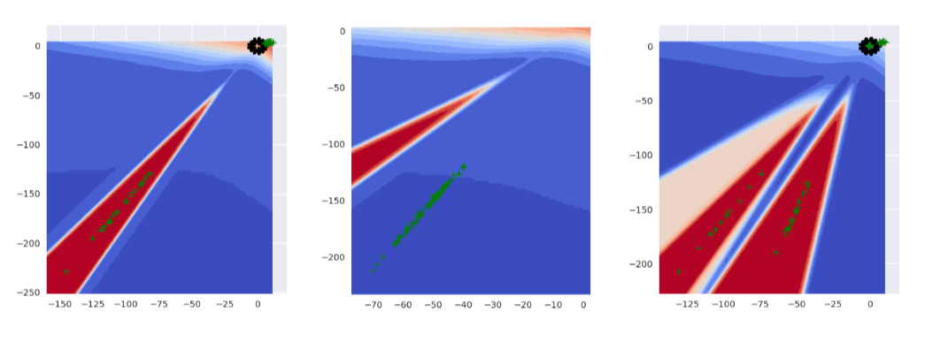
Simulations
Iterative improvement of mixed state Nash Equilibrium
(Could be a slow process)
Black - Real Data Green - Fake Data

Slide 20
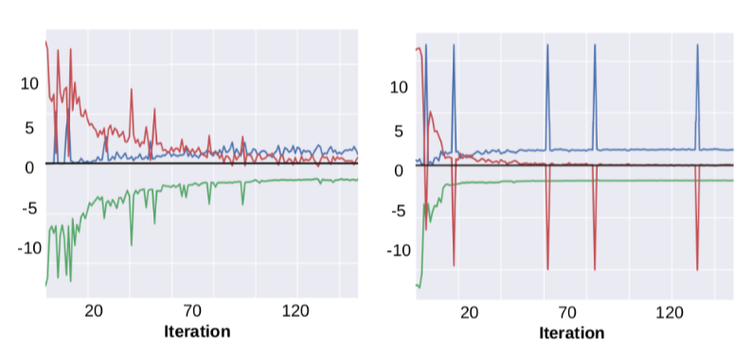
Simulations - Adding Uniform Fake samples
Adding uniformly sampled fake data in the bounding box spanned by the real and fake images
PNM PNM w Uniform Fake Samples

Slide 21
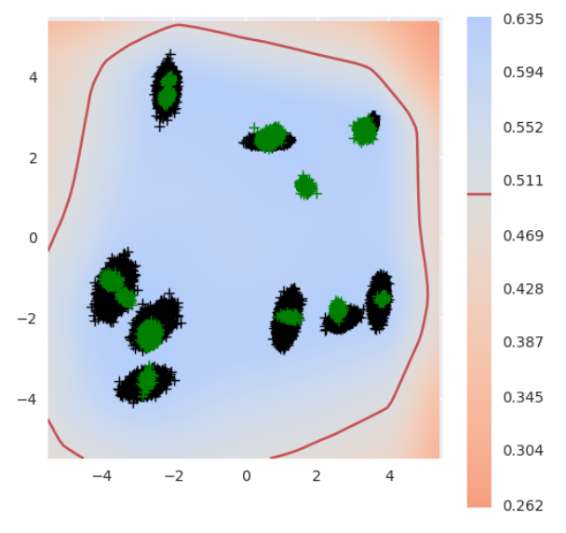
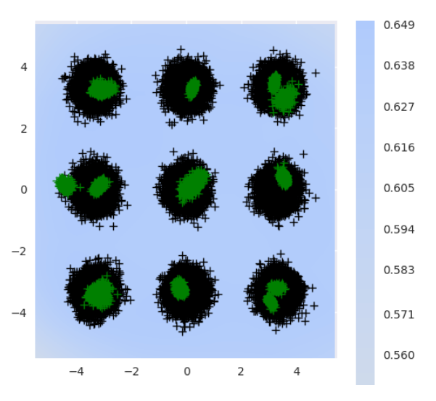
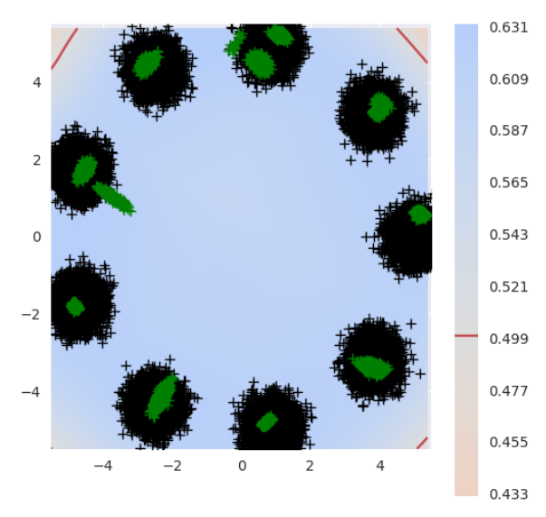
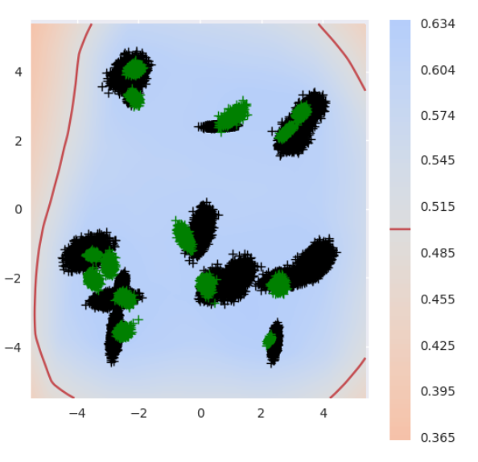
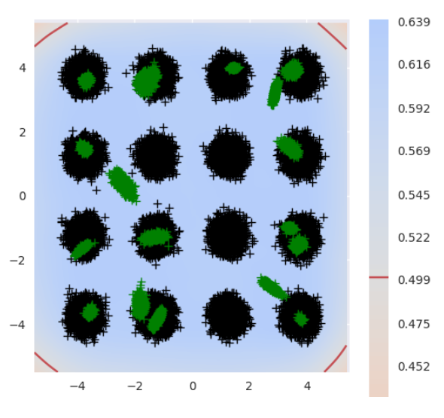
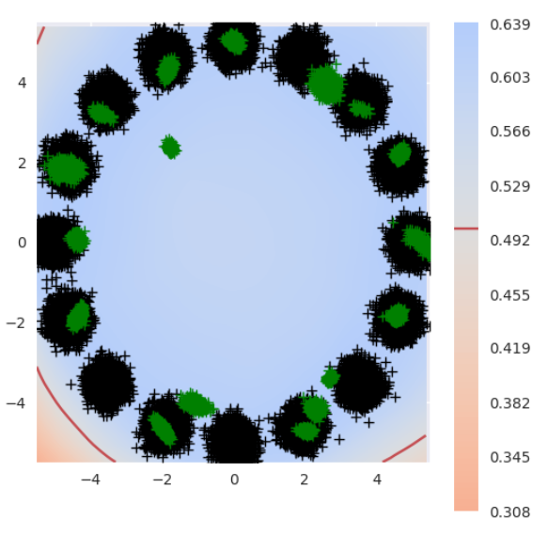
Simulations
Black - Real Data Green - Fake Data

Slide 22
Thank You!

